Slide 1



ANNUAL
PIZZA
SALES
SQL REPORT
Overview of Sales Performance and Key Insights

Slide 2

TABLE OF CONTENTS
BASIC QUERIES
INTERMEDIATE QUERIES
ADVANCED QUERIES
GitHub : https://github.com/darshilx07-cloud/SQL-Projects/blob/main/Pizza%20Sales%20WS%20Cubetech.sql
Dataset : https://github.com/darshilx07-cloud/SQL-Projects/blob/main/pizza_sales%20(1).zip

Slide 3

Greetings!
I am DARSHIL MATHUR
Here, I showcase my SQL Queries Work (Basic – 5, Intermediate – 5, Advanced – 3), reflecting both learning and application.
This project gave me hands-on practice with real-world problem-solving using SQL and improved my ability to structure and optimize queries across different difficulty levels.

Slide 4
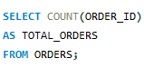

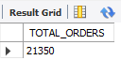
TOP 5 BASIC QUERIES
1. RETRIEVE THE TOTAL NUMBERS OF ORDER PLACES?
QUERY :
RESULT :

Slide 5
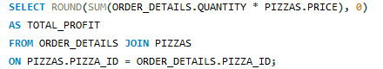
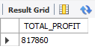

2. Calculate the total revenue generated from pizza sales?
QUERY :
RESULT :

Slide 6
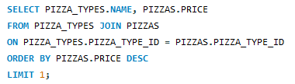
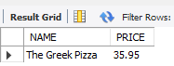
3. Identify the highest-priced pizza?
QUERY :
RESULT :

Slide 7
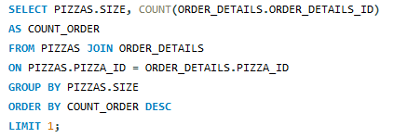
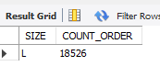
4. Identify the most common pizza
size ordered?
QUERY :
RESULT :

Slide 8
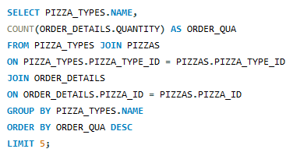
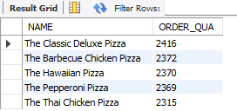
5. List the top 5 most ordered pizza types along with their quantities?
QUERY :
RESULT :

Slide 9
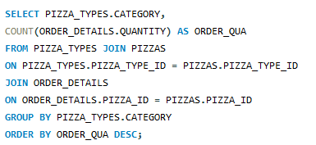
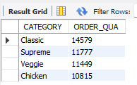
TOP 5 INTERMEDIATE QUERIES
1. Join the necessary tables to find the total quantity of each pizza category ordered?
QUERY :
RESULT :

Slide 10
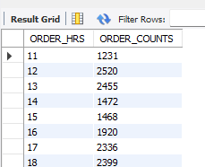
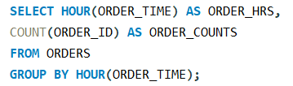
2. Determine the distribution of orders by hour of the day?
QUERY :
RESULT :

Slide 11
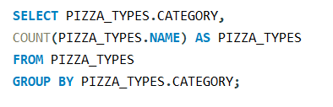
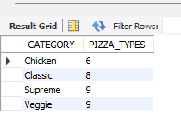
3. Join relevant tables to find category-wise distribution of pizzas?
QUERY :
RESULT :

Slide 12
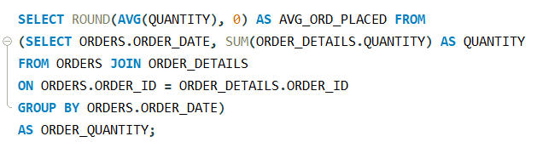
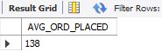
4. Group the orders by date and calculate the average number of pizzas ordered per day?
QUERY :
RESULT :

Slide 13
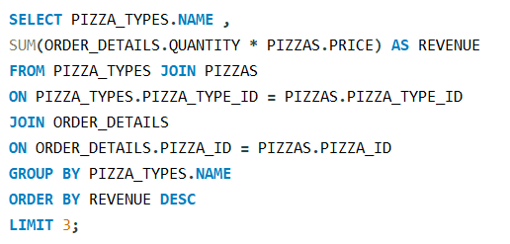
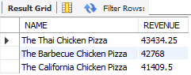
5. Determine the top 3 most ordered pizza types based on revenue?
QUERY :
RESULT :

Slide 14
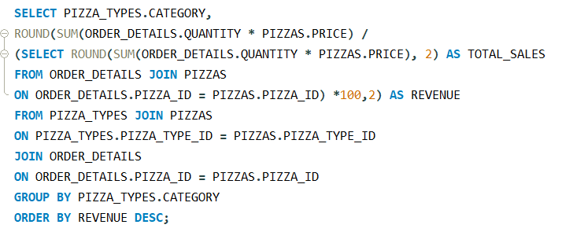
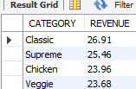
TOP 5 ADVANCED QUERIES
1. Calculate the percentage contribution of each pizza type to total revenue?
QUERY :
RESULT :

Slide 15
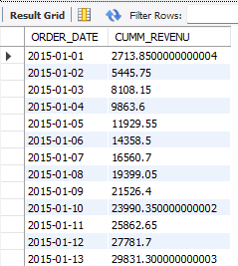
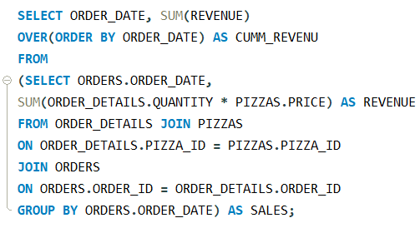
2. Analyze the cumulative revenue generated over time?
QUERY :
RESULT :

Slide 16
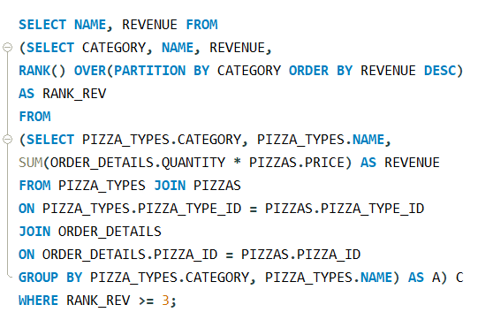
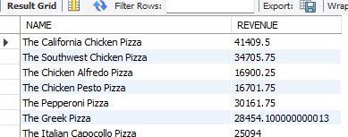
3. Determine the top 3 most ordered pizza types based on revenue for each pizza category?
QUERY :
RESULT :

Slide 17
Thank You

